Slide 1
TU856-1 and TU858-1 Computer Architecture and Technology
Thursday 27 February 2025
(Week 5) Tutorial 3

Slide 2
Questions and Answers ( 1 )
What is the relationship between Boolean algebra and the binary (base 2) numbering system?
The binary number representation happens to be a useful representation for the circuits, signals and data flow inside a computer.
The Boolean algebra notation happens to be a useful representation for the EVENTS of data movement – and the EFFECTS of OPERATION of logic gates in many components of the computer system, particularly those on the processor, ROM and RAM.

Slide 3
Questions and Answers ( 2 )
What is the Law of Rational Inference again?
The idea of ‘rationally inferring’ suggests that, when observing conditions, your conclusion can be drawn from given premises. So, if A and B are equal, and you know that A = 1, your rational inference should be that B = 1.
Rational inference can be made through deductive or inductive reasoning. (You either deduce or are told…)

Slide 4
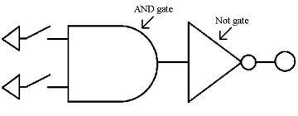
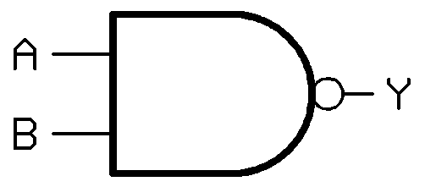
Questions and Answers ( 3 )
… onward to gates…
Can an AND gate become a NAND gate?
Yes – just fit a NOT gate on the output point of an AND gate.

Slide 5
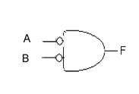
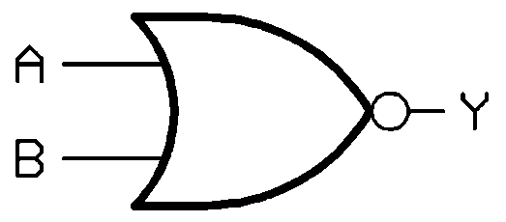
Questions and Answers ( 4 )
Can an AND gate become a NOR gate?
Yes. Place NOT gates on both inputs of an AND gate – it will perform like a NOR gate.
=

Slide 6
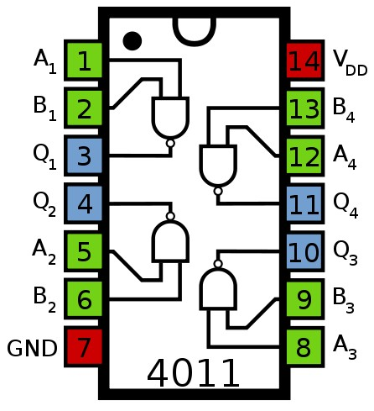
Gates in a Chip
CMOS IC 4011 NAND gate dual input

Slide 7
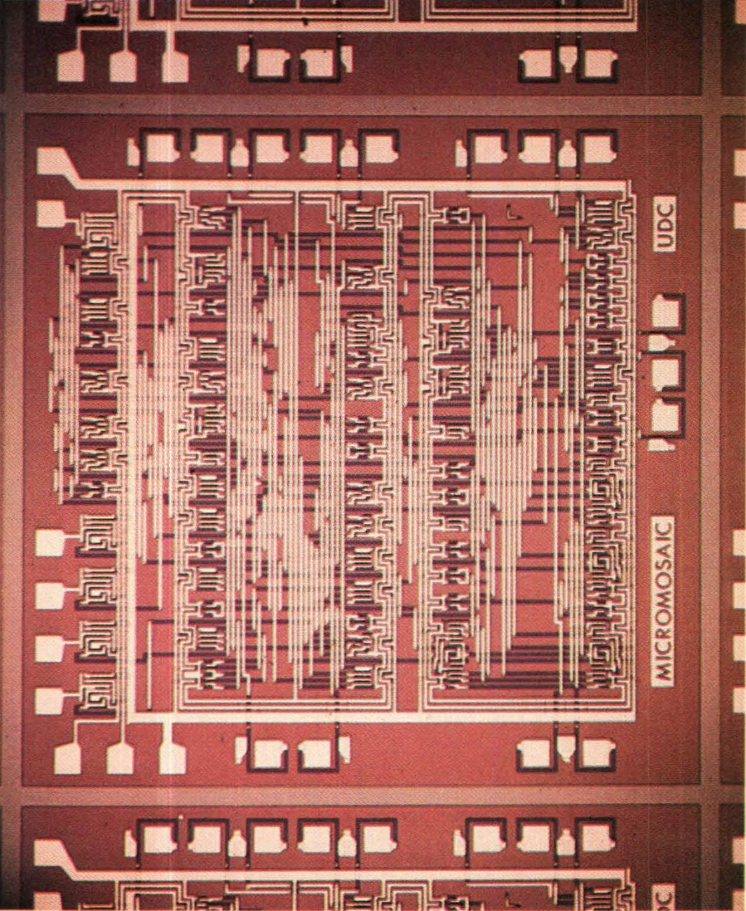
This logic chip, made by Fairchild in 1967, had transistors (the dark horizontal lines) that could be hooked up in almost any pattern of logic gates by changing the arrangement of aluminum interconnections (the vertical beige lines) during manufacture.
Thus the chip could be customised to meet the needs of many different users.
The chip on the left is .048 inch long and .038 inch wide; the chip on the right, which contains about 150 logic gates, is .15 inch square.

Slide 8
Typical Exam (Sub) Question For This Content
Question
What are the three fundamental types of logic gates? Describe the function of each.
Sample solution
Modern computers operate solely on the binary numbers "1" and "0." All the instructions that direct a computer's operation exist as a sequence of such binary digits or bits (0s and 1s).
Binary digits (or logical variables) are processed in the machine as distinct voltage states in tiny electronic circuits known as logic gates.
A logic gate only recognizes two varieties of input, high-voltage (value of 1 or TRUE) and low-voltage (value of 0 or FALSE).

Slide 9
Solution continued
The truth variables of Boolean algebra use the functionality of the logical concepts of AND, OR and NOT.
It will come as no surprise, therefore, that the logic gates (as electronic mechanisms) are AND, OR, and NOT.
These gates, used in differing combinations, allow the computer to execute all its operations.
Each logic gate of the types AND and OR takes in two or more bits in the form of such voltages, combines them according to a built-in rule, and produces a single high-voltage or low-voltage logical conclusion (output).
NOT gates usually have one input and one output.
Logic gates are the fundamental building blocks of all digital logic circuits – they are switching circuits that perform certain simple operations on binary signals: they allow for bits and bytes to be shifted through circuits and/or converted in the CPU.

Slide 10
Solution continued
An AND gate takes two inputs of either 0 or 1 and, where both inputs are 1, gives a 1 output, otherwise the output is 0.
An OR gate takes two inputs of either 0 or 1 and, where either inputs are 1, gives a 1 output, otherwise the output is 0.
A NOT gate takes one input of either 0 or 1 and, where the input is 0, gives a 1 output, where the input is 1, gives a 0 output.
(10 marks)

